Slide 1


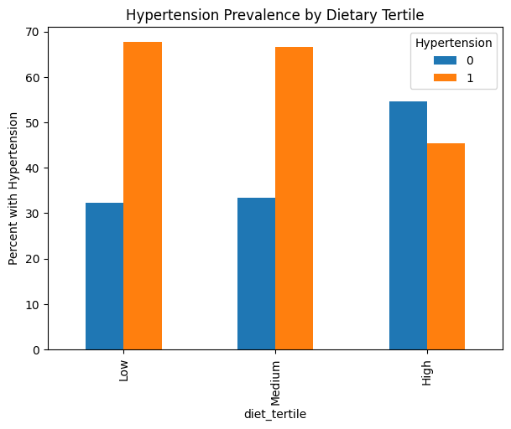
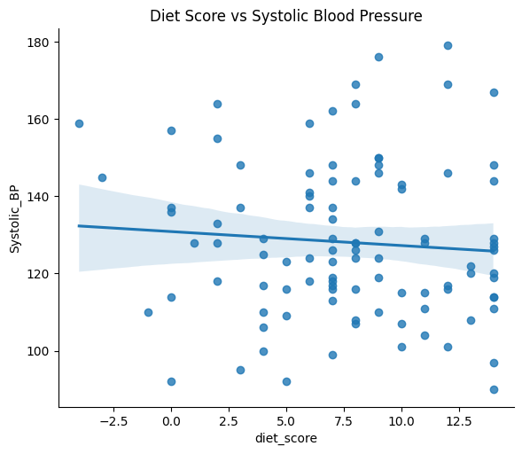
Diet Quality as a Predictor of Hypertension Risk
Temi Falae
Rollins School of Public Health
Abstract/Intro/Motivation
Results
Conclusions/Future Directions
Hypertension is a leading risk factor for cardiovascular disease and remains highly prevalent among adults worldwide. Dietary behaviors, including fruit, vegetable, and confectionary consumption, are modifiable factors that may influence blood pressure and cardiovascular risk. While individual dietary components have been studied extensively, less is known about how overall diet quality relates to hypertension prevalence. This study examines the association between dietary patterns and diet quality scores with hypertension in an adult population.
Hypertension prevalence exceeded 65% among participants in the low and medium diet tertiles but was lower among those in the high diet tertile (45.5%). In adjusted analyses, higher diet quality scores were associated with lower odds of hypertension (OR = 0.90 per unit increase; 95% CI: 0.80–1.01). Older age was associated with higher odds of hypertension (OR = 1.03 per year). No evidence of problematic multicollinearity was observed among model covariates.
What is the central research problem or question you have been helping to explore?
What work has been done previously in this area?
This section can be a review of the literature that has been most important in your research area
Higher diet quality was associated with a lower prevalence of hypertension, though associations did not reach statistical significance after adjustment. These findings suggest that overall dietary patterns may play a protective role in hypertension risk. Larger and longitudinal studies are needed to further evaluate the relationship between diet quality and blood pressure outcomes.
Methods/Approach
We conducted a cross-sectional analysis of 100 adults. Hypertension was defined as systolic blood pressure ≥130 mmHg or diastolic blood pressure ≥80 mmHg. Primary exposures included a continuous diet quality score and diet tertiles (low, medium, high). Descriptive statistics were used to characterize the sample. Logistic regression models estimated the association between diet quality and hypertension, adjusting for age, gender, race, education, income, body mass index (BMI), and waist circumference. Multicollinearity was assessed using variance inflation factors.
Acknowledgements
We used Python for data analysis

